Slide 1

Chapter 3:
Expressions
and Interactivity

Slide 2
3.7
Formatting Output

Slide 3

Formatting Output
Can control how output displays for numeric, string data:
  size
  position
  number of digits
Requires iomanip header file

Slide 4
Stream Manipulators
Used to control how an output field is displayed
Some affect just the next value displayed:
  setw(x): print in a field at least x spaces wide. Use more spaces if field is not wide enough

Slide 5
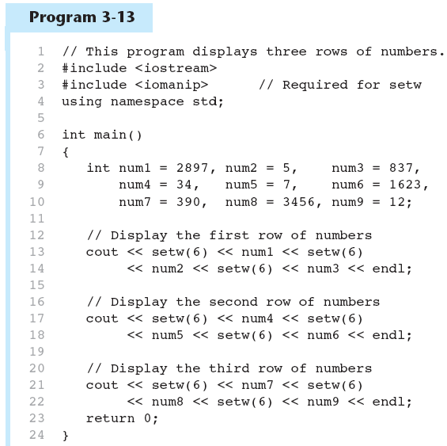
The setw Stream Manipulator in Program 3-13
Continued…

Slide 6
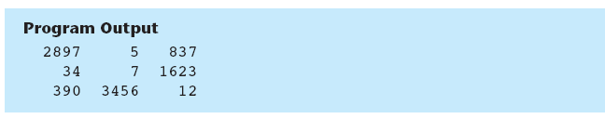
The setw Stream Manipulator in Program 3-13

Slide 7
Stream Manipulators
Some affect values until changed again:
  fixed: use decimal notation for floating-point values
  setprecision(x): when used with fixed, print floating-point value using x digits after the decimal. Without fixed, print floating-point value using x significant digits
  showpoint: always print decimal for floating-point values

Slide 8
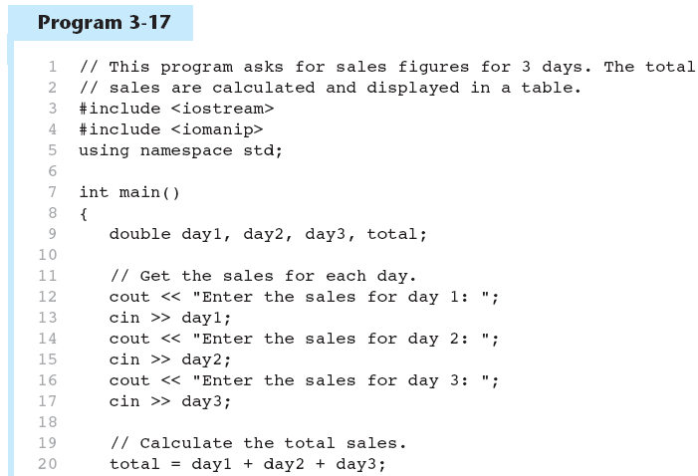
More Stream Manipulators in Program 3-17
Continued…

Slide 9
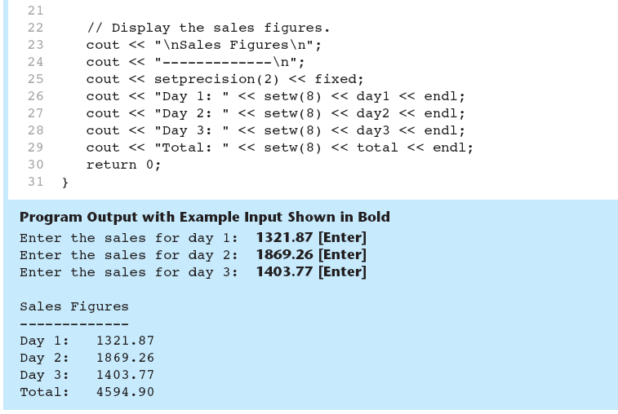
More Stream Manipulators in Program 3-17

Slide 10
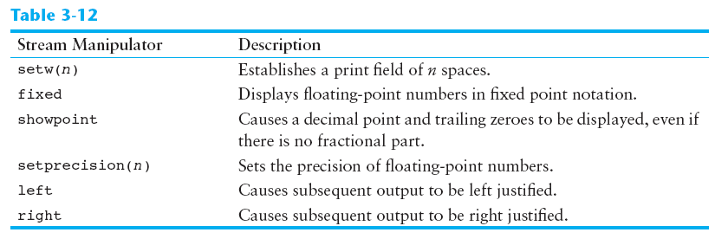
Stream Manipulators

Slide 11
3.1
The cin Object

Slide 12
The cin Object
Standard input object
Like cout, requires iostream file
Used to read input from keyboard
Information retrieved from cin with >>
Input is stored in one or more variables

Slide 13
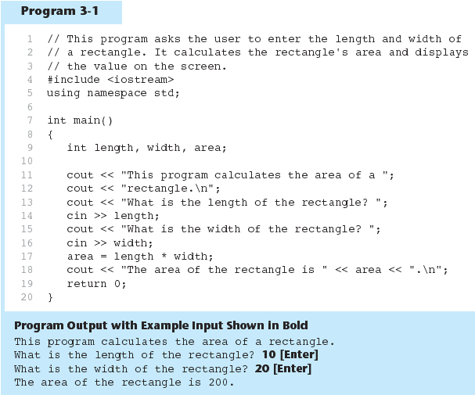
The cin Object in Program 3-1

Slide 14
The cin Object
cin converts data to the type that matches the variable:
  int height;
  cout << "How tall is the room? ";
  cin >> height;

Slide 15
Displaying a Prompt
A prompt is a message that instructs the user to enter data.
You should always use cout to display a prompt before each cin statement.
cout << "How tall is the room? ";
cin >> height;

Slide 16
The cin Object
Can be used to input more than one value:
  cin >> height >> width;
Multiple values from keyboard must be separated by spaces
Order is important: first value entered goes to first variable, etc.

Slide 17
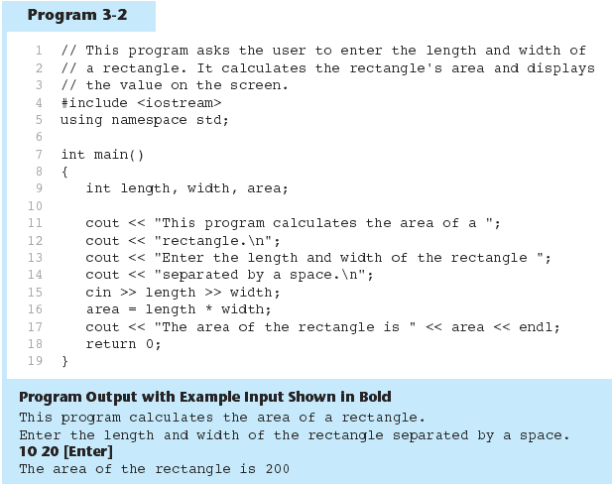
The cin Object Gathers Multiple Values in Program 3-2

Slide 18
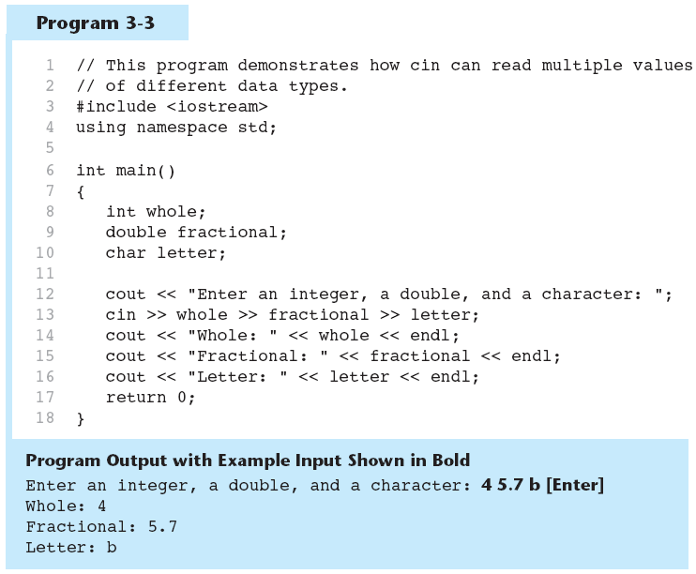
The cin Object Reads Different Data Types in Program 3-3

Slide 19
3.2
Mathematical Expressions

Slide 20
Mathematical Expressions
Can create complex expressions using multiple mathematical operators
An expression can be a literal, a variable, or a mathematical combination of constants and variables
Can be used in assignment, cout, other statements:
  area = 2 * PI * radius;
  cout << "border is: " << 2*(l+w);

Slide 21
Order of Operations
In an expression with more than one operator, evaluate in this order:
  - (unary negation), in order, left to right
  * / %, in order, left to right
  + -, in order, left to right
In the expression 2 + 2 * 2 – 2
evaluate
first
evaluate
third
evaluate
second

Slide 22
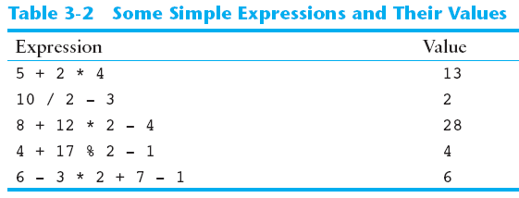
Order of Operations

Slide 23
Associativity of Operators
- (unary negation) associates right to left
*, /, %, +, - associate right to left
parentheses ( ) can be used to override the order of operations:
  2 + 2 * 2 – 2 = 4
  (2 + 2) * 2 – 2 = 6
  2 + 2 * (2 – 2) = 2
  (2 + 2) * (2 – 2) = 0

Slide 24
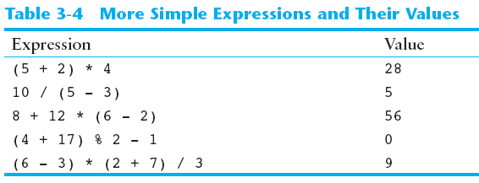
Grouping with Parentheses

Slide 25
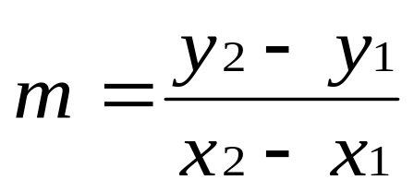
Algebraic Expressions
Multiplication requires an operator:
  Area=lw is written as Area = l * w;
There is no exponentiation operator:
  Area=s² is written as Area = pow(s, 2);
Parentheses may be needed to maintain order of operations:
  is written as
  m = (y2-y1) /(x2-x1);

Slide 26
3.6
Multiple Assignment and Combined Assignment

Slide 27
Multiple Assignment and Combined Assignment
The = can be used to assign a value to multiple variables:
  x = y = z = 5;
Value of = is the value that is assigned
Associates right to left:
  x = (y = (z = 5));
value
is 5
value
is 5
value
is 5

Slide 28
Combined Assignment
Look at the following statement:
  sum = sum + 1;
  This adds 1 to the variable sum.

Slide 29
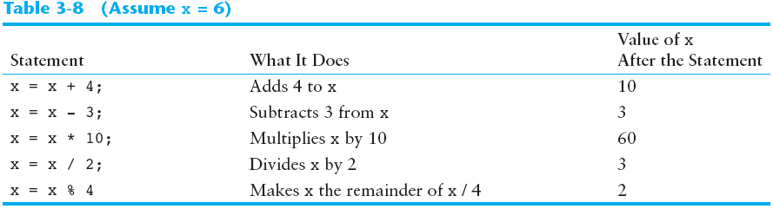
Other Similar Statements

Slide 30
Combined Assignment
The combined assignment operators provide a shorthand for these types of statements.
The statement
  sum = sum + 1;
  is equivalent to
  sum += 1;

Slide 31
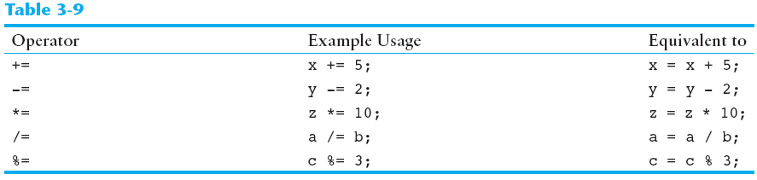
Combined Assignment Operators

